Slide 1
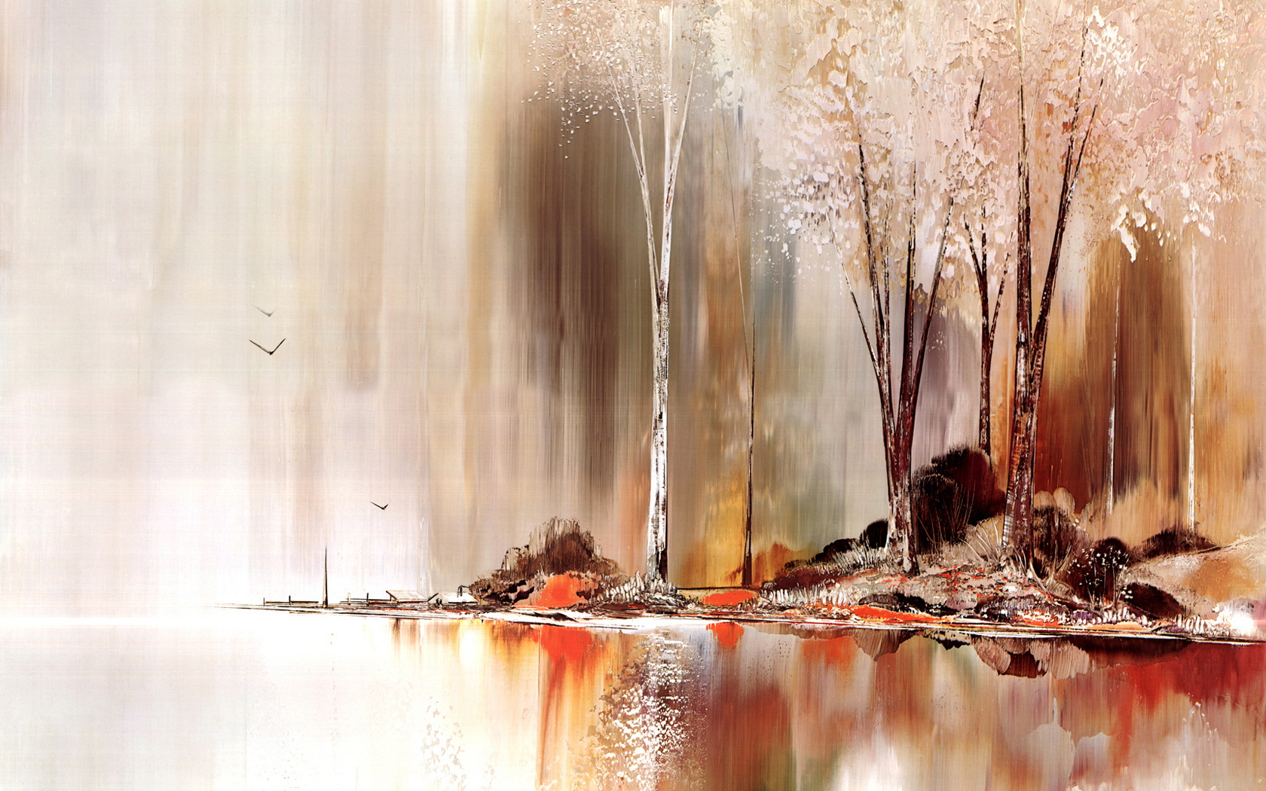
Edward Estlin Cummings

Slide 2

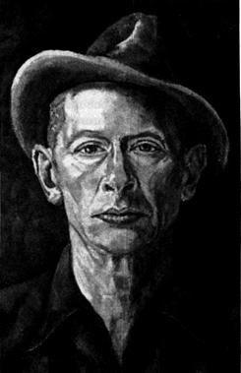
Early years
Edward Estlin Cummings, poet, playwright, novelist, and painter
He was born in Cambridge, Massachusetts, on October 14, 1894.
His mother, Rebecca, who loved to spend time with her children, played games with Cummings and his sister, Elizabeth. It was Cummings's mother who introduced him to the joys of writing. Cummings wrote poems and also drew as a child, and he often played outdoors with the many other children who lived in his neighborhood.

Slide 3
He also grew up in the company of such family friends as the philosophers William James (1842–1910) and Josiah Royce (1855–1916). He graduated from Harvard University in 1915 and then received an advanced degree from Harvard in 1916.

Slide 4
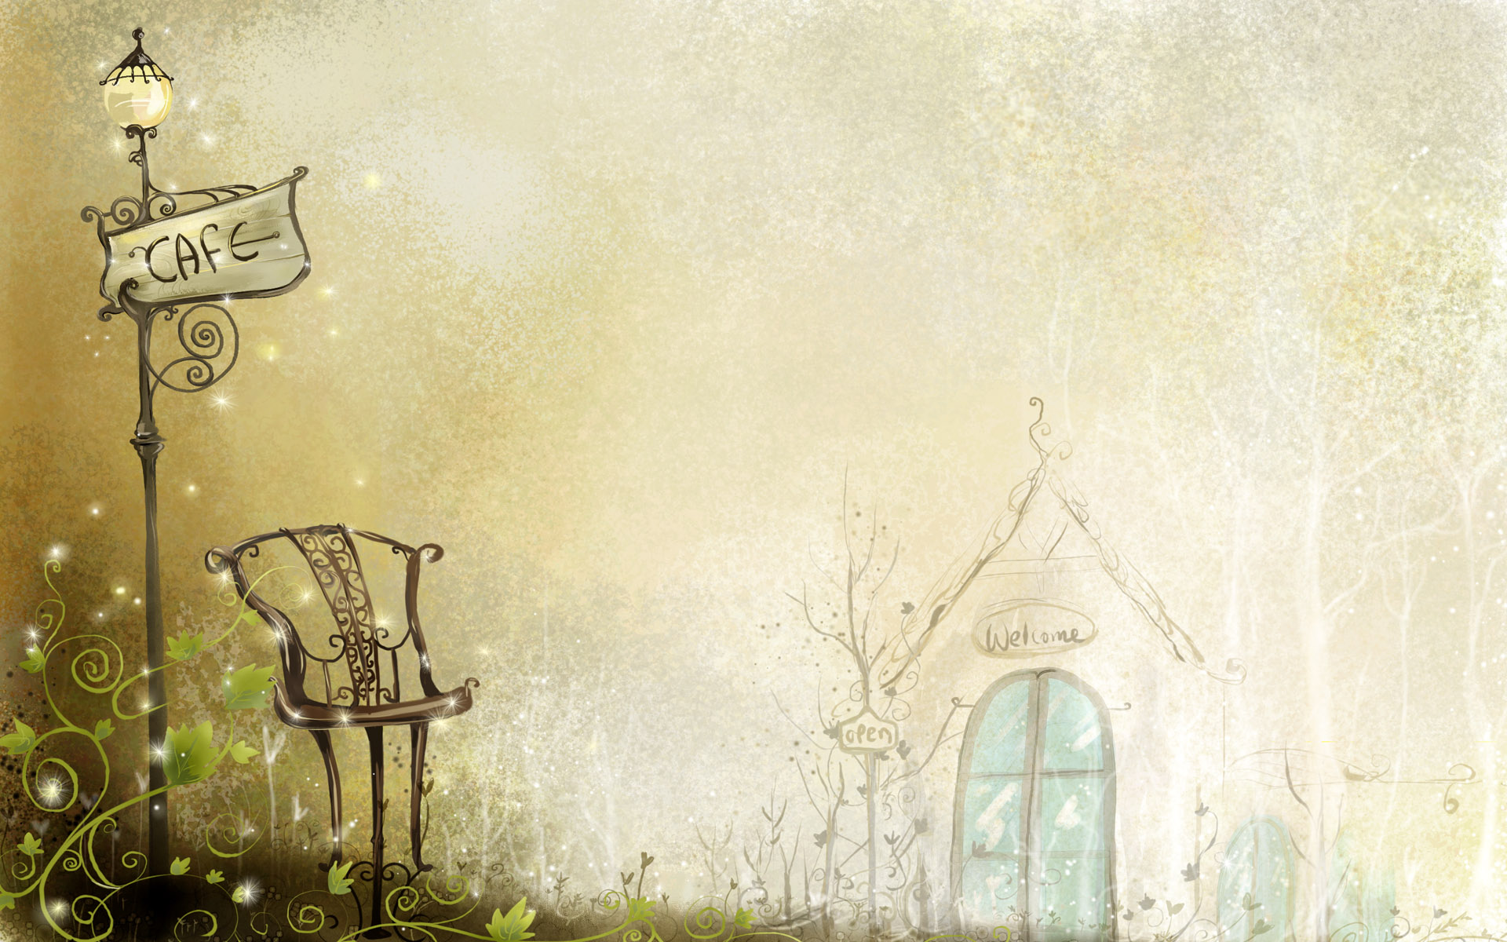
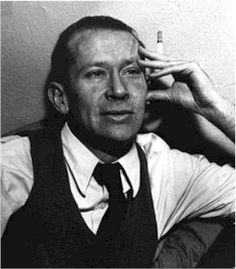
He was named after his father but his family called him by his middle name, Estlin.^{[2]} His father was a professor of sociology and political science at Harvard University and later a Unitarian minister.^{[3]} Cummings described his father as a person who could accomplish anything that he wanted to. Edward was well skilled and was always working or repairing things. He and his son were close, and Edward was one of Estlin's most ardent supporters.

Slide 5
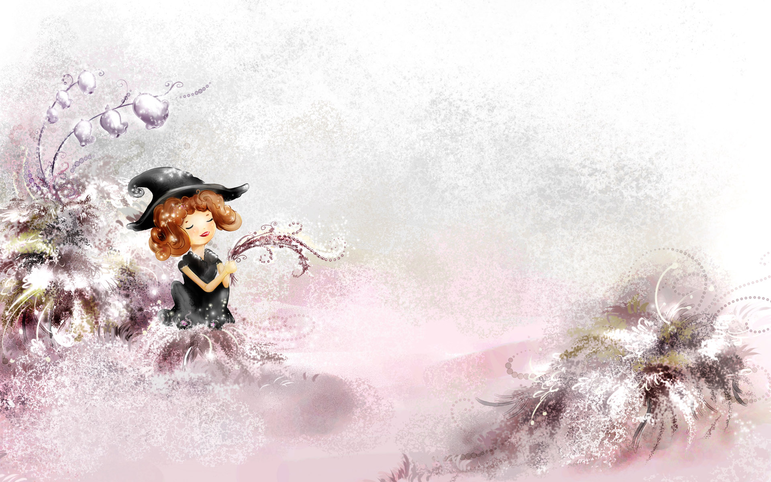
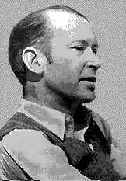
Early career
After graduating, Cummings became an ambulance driver in France just before America entered World War I (1914–1918; a war involving most European countries and, later, the United States). He was imprisoned for three months on suspicion of holding views critical of the French war effort, and this experience provided the material for his first book, The Enormous Room (1922).

Slide 6
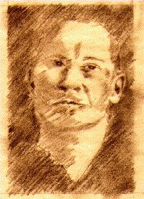
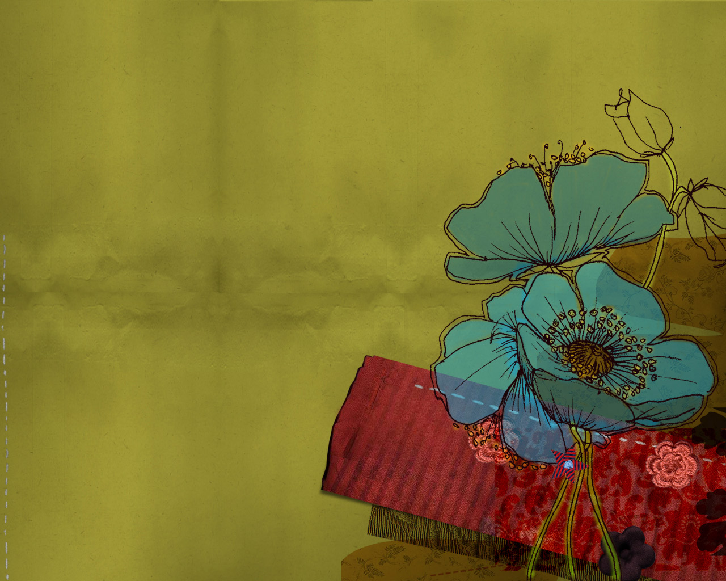
Cummings's romantic transcendentalism (which stressed the individual human being and his or her emotional experiences, the worship of nature, and the "spiritual"—or nonmaterial—basis of reality) resulted in the early rejection of his work, for it was not popular at the time. For several decades he had to pay for the publication of his work, and reviewers revealed very little understanding of his aims. His first volume of poems, Tulips and Chimneys (1923), was followed by a second volume two years later. Though Cummings received the Dial Award for poetry in 1925, he continued to have difficulty in finding a publisher.

Slide 7

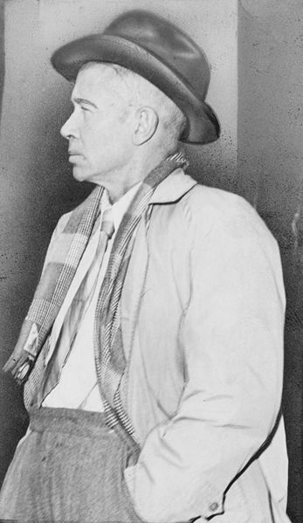
Poetic methods and achievement
Despite his dedication to growth and movement, and in contrast to his reputation as an experimenter in verse forms, Cummings actually tended to lack fresh invention. Especially in the 1930s, when he felt separated from his culture and his fellow poets, he repeated himself endlessly, writing many versions of essentially the same poem

Slide 8

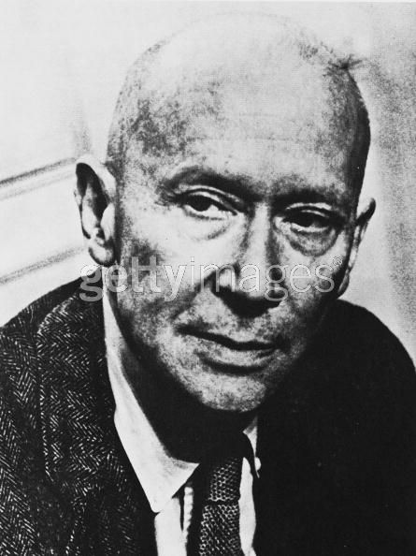
Many of Cummings's devices, such as the visual "shaping" of poems, often seem like substitutes for original inspiration. However, Cummings's most characteristic devices—the unique, personal grammar and the breaking up and putting back together of words into different forms—were more than just another trick when they operated within the context of a poem's meaning.

Slide 9

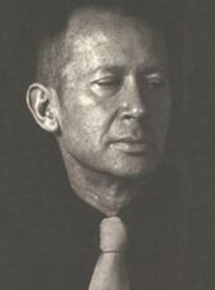
Early in his career Cummings had divided his time between New York City and Paris, France, where he studied painting. Later in his career he divided his time between New York City and the family home in North Conway, New Hampshire. He was always interested in the visual arts, and his paintings and drawings were exhibited in several one-man shows in the 1940s and 1950s.

Slide 10

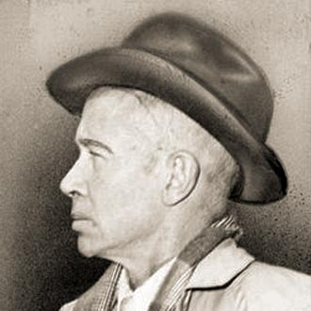
After 1945 a new generation of poets in rebellion against the poets of the previous generation began to find in Cummings an echo of their own ideas about poetry, and Cummings began to receive the recognition that had escaped him for so long.
In 1950 the Academy of American Poets awarded Cummings, a self-described "failure," a fellowship for "great achievement," and his collection Poems, 1923–1954 (1954) won praise from people who had earlier tended to criticize Cummings for his romanticism.

Slide 11
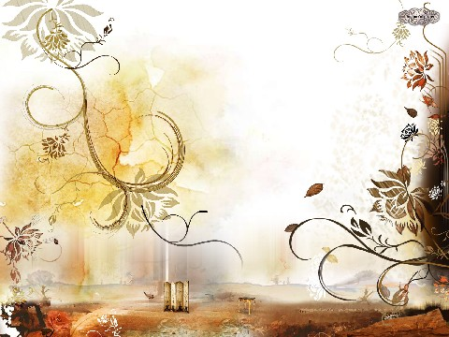
Late works
E. E. Cummings, poet and cubist painter, was the representative of American modern experimental poets. As a poet and painter, Cummings reflected the harmony of poems and paintings in his works, eschewing the conventional rhymes and syntactic structure of poems and even rejecting to transfer information and emotion in the way of conventional printing.

Slide 12

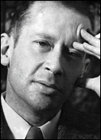
Cummings did not "develop" as a poet either in terms of ideas or of characteristic style. However, between the publication of his first volume and his final, called 73 Poems (1963), his work does show a deepening awareness and mastery of his special gift as poet of the mysteries of "death and forever with each breathing." His finest single volume is often said to be 95 Poems (1958). Cummings's Collected Poems was published in 1960.

Slide 13
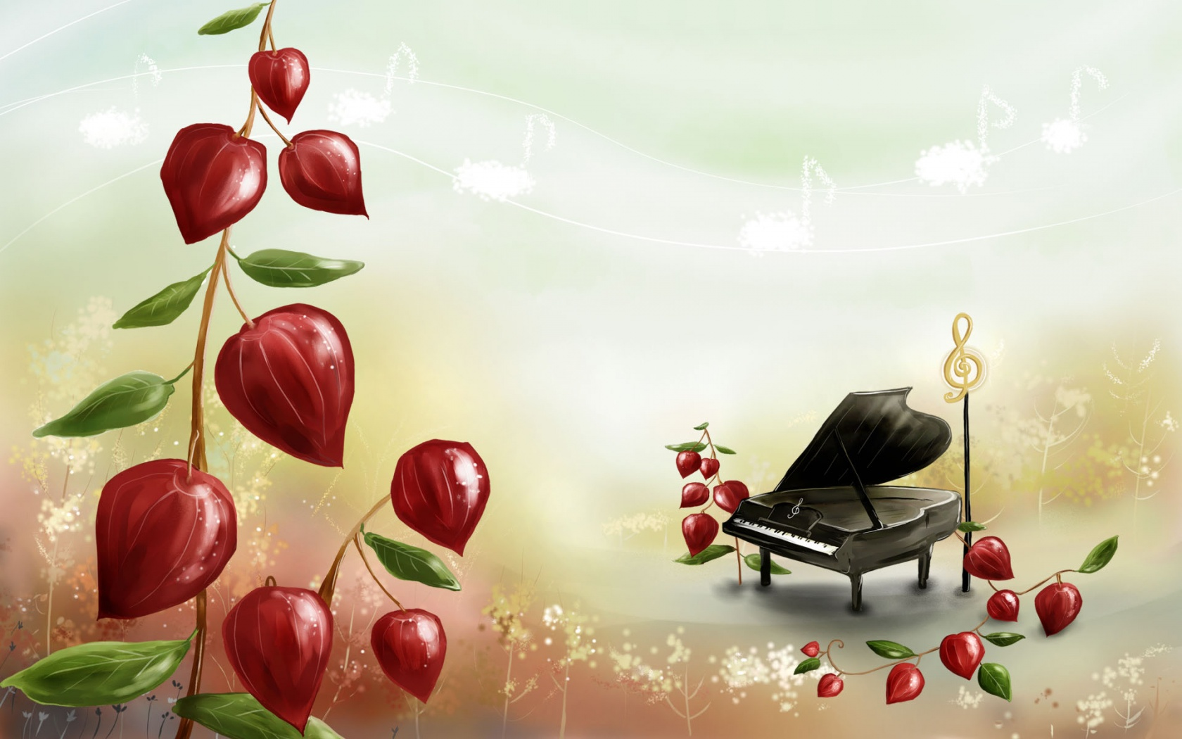
Titled Adventures in Value (1962), this work is a good example of his lifelong effort to see intensely and deeply enough to confront the miracles of nature. If only a tenth of his poems should be thought worthwhile, Cummings will have been established as one of the more lasting poets America has produced.

Slide 14
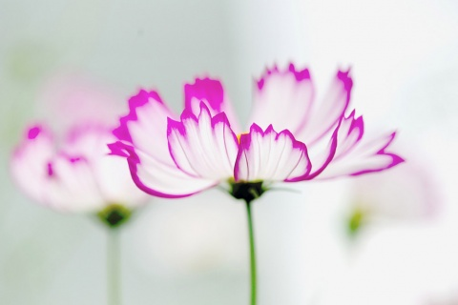
هند الغامدي
هناء الجحدلي
نجاح القرني
ليلى السلمي
نوره الشهري
عهودالنزاوي

